Slide 1
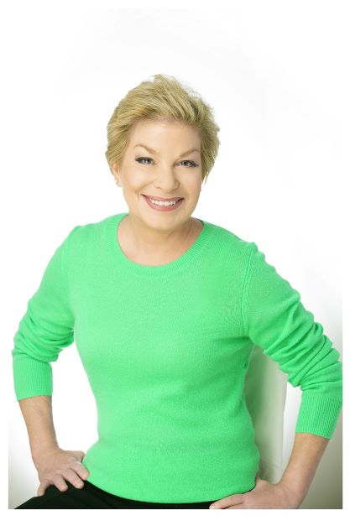
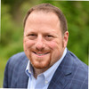
Getting Your Organization Prepared Before Launching Any Campaign
Michael J. Baker, CFRE, Founder & Partner, M3Development
Laura Fredricks, JD, Fundraising Consultant, Author, Speaker

Slide 2
When you hear the word "Campaign" what is the first word that comes to mind?
ⓘ Start presenting to display the poll results on this slide.

Slide 3
How Many of You are considering starting a Campaign?
ⓘ Start presenting to display the poll results on this slide.

Slide 4
How many of you have Campaign Experience?
ⓘ Start presenting to display the poll results on this slide.

Slide 5
Are you Campaign Ready?
What do you think are the most important things you should be considering before you launch any campaign?

Slide 6
The 5 MUSTs Before a Campaign Decision
1. Board that is committed to conducting a campaign
2. DEI&A and Community Engagement Programs
3. Staff and Campaign Experience
4. Budget that is agreed upon and approved
5. Bandwidth to do regular AND campaign fundraising activities

Slide 7
What is your Why?
Why does your organization want to do a campaign?
Why does it want to do it now?
Do these reasons fit squarely within your existing or upcoming strategic plan?
Is the decision based on needing more space, needing upgrades or improvements, needing more cash flow?

Slide 8
What is your Why?
Is the campaign purely for “capital needs” or should it be a combined with an endowment, a “stability fund?”
Have you tested other campaigns first such as an “annual fund campaign,” “matching gifts campaign?”

Slide 9
The Basics for any Campaign
Compelling Case for Support
Unanimous Board endorsement and 100% participation
Adequate pool of relevant and financially capable donors and prospects
Critical mass of identifiable and willing volunteers
Campaign Planning

Slide 10
Big Questions to ASK
Does every campaign need a feasibility study?
What if all my board members are not 100% keen on the idea of having a campaign?
How do I know if my current staff can support the campaign?
Are there key staff roles that are essential for any campaign?
How do we decide if we need Campaign Consultants?

Slide 11
Big Questions to ASK
What exactly is a campaign plan?
How do we determine how long the campaign should be?
What should we be looking for when we select a campaign chair or co-chairs?
Can they be people who are not currently on our board?
Who should be on the campaign committee and how many members do we need?

Slide 12
Big Questions to ASK
Should my board and/or staff have campaign training before and during the campaign?
Outside of the board and the committee, what is the role of a volunteer for the campaign?
Do we need a separate budget for campaign materials and marketing?
What are the most successful donor recognition programs during and after a campaign?

Slide 13
Big Questions to ASK
Is it still the rule that you need 60% or more of the funds raised to goal before the campaign goes “public?”
What if we are near the end of our stated timeline for the campaign but we have not reached our campaign goal?
Do you always increase the goal if you have raised the goal amount before the end of the campaign timeline?

Slide 14
Questions & Answers

Slide 15
Stay in Touch
Laura Fredricks , JD
(917) 796- 2325
Laura@ExpertonTheAsk.com
www.ExpertOnTheAsk.com
Michael J. Baker, CFRE
(732) 245-9868
mbaker@m3development.net
www.m3development.net

